Slide 1
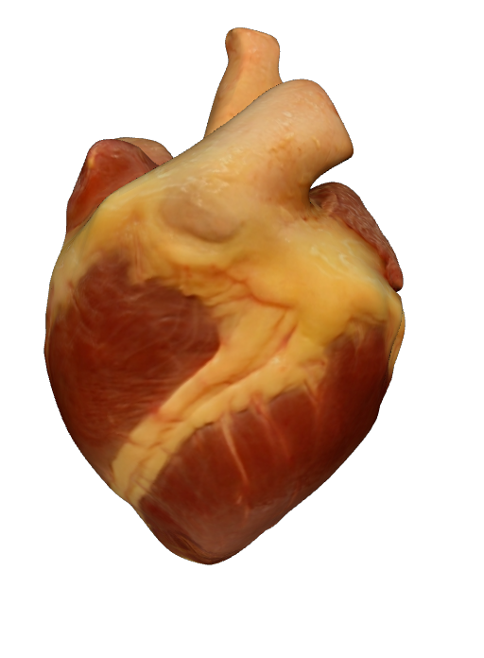
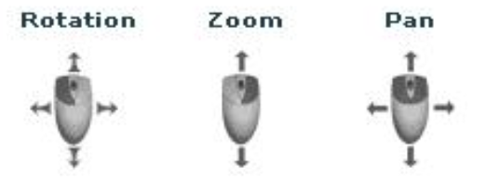
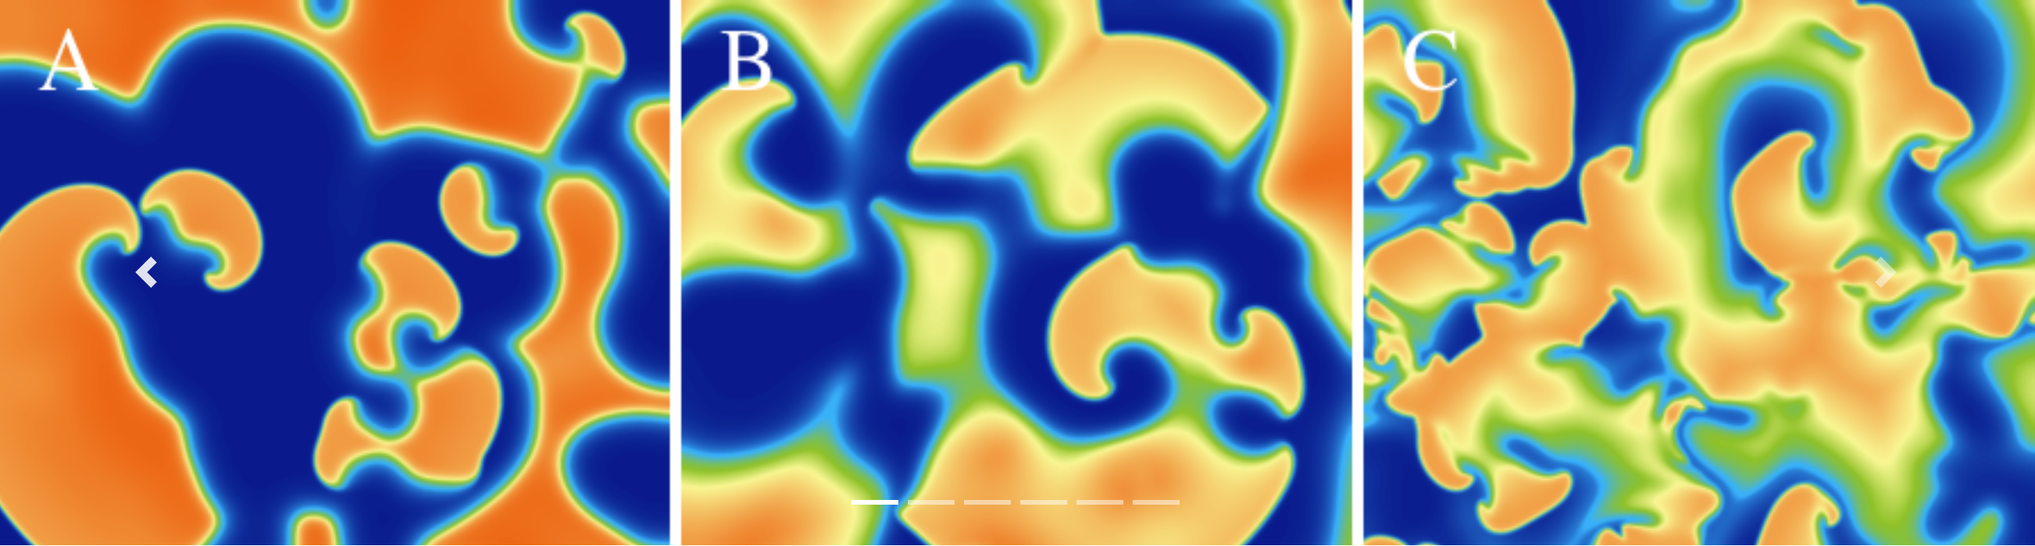
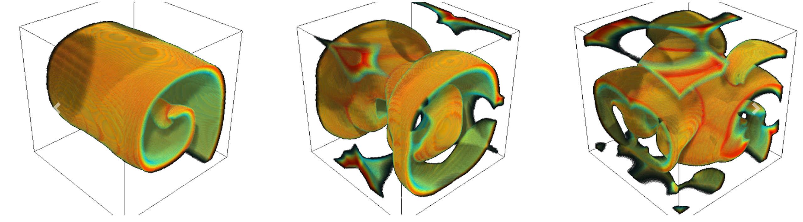
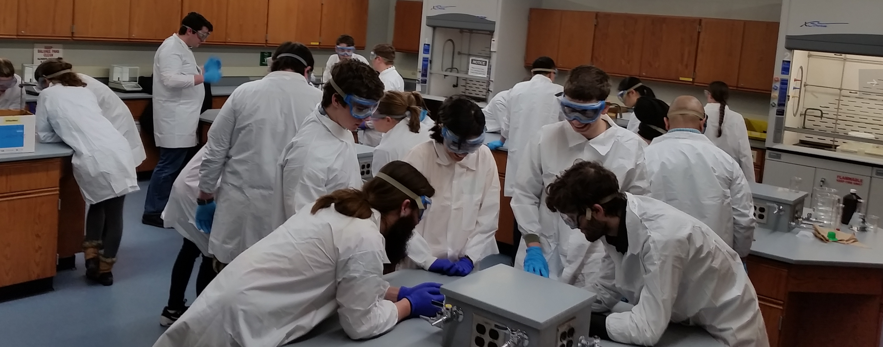
Home About Us Research Publications People Teaching News Press Software Lab Pics
Welcome to the CHAOS Lab. we use a combined approach of theory, simulation, and experiments to investigate complex systems.
Experiments in complex systems: Cardiac dynamics using micro-electrodes and optical mapping, active media (swarms and murmuration), chemical reactions, table top experiments.
Mathematical modeling of complex systems: Development and analysis of mathematical models that describe generic or detailed dynamics of excitable and oscillatory media.
High performance computing: Development and implementation of novel algorithms to solve partial differential equations in two- and three-dimensional regular and irregular domains and parallel computing using GPUs.

Slide 2
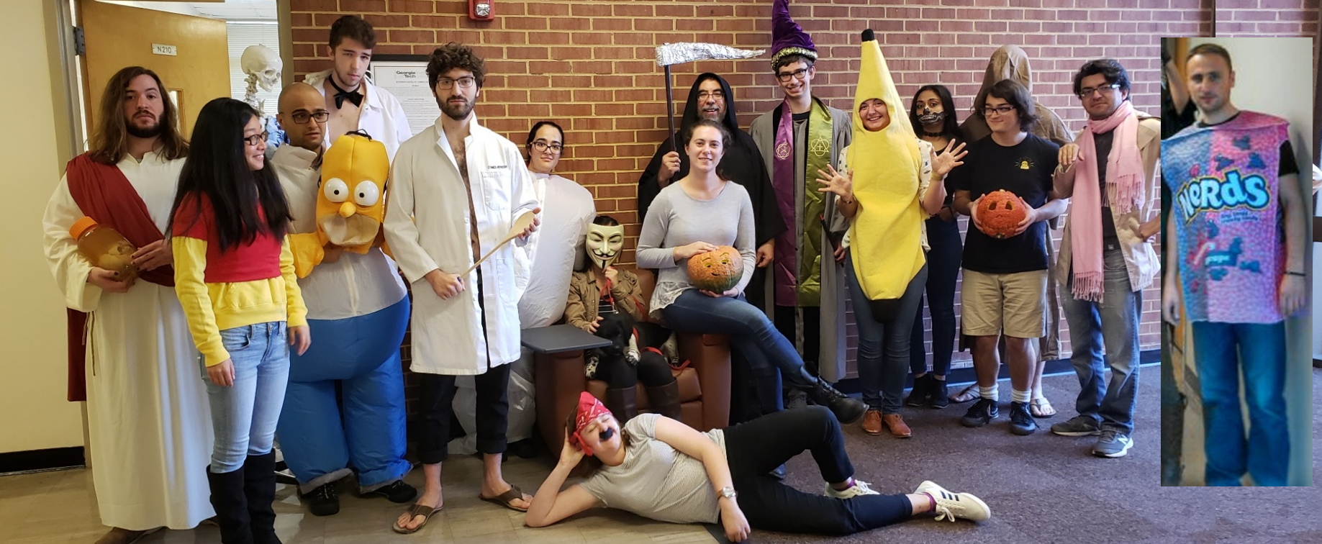

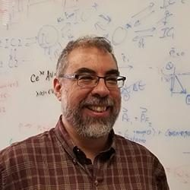
Home About Us Research Publications People Teaching News Press Software Lab Pics
Flavio H Fenton
Professor of Physics, Georgia Institute of Technology
Adjunct Professor of Biology
CV.pdf (in GT formatted style)
More info about me
Google scholar
Email: Flavio.Fenton[at]physics.gatech.edu
office: 204 Howey Building Lab: 20x Howey Building

Slide 3

Research Scientist
Research Scientist:
Abouzar and Ilija
Post Doc
Kamal Sharma
Graduate students:
Conner Herndon
Hector Velasco Perez
Noah DeTal
Mikael Toye
Giraldo Pino
Lynn Jin
-------------------
Undergraduates:
Shaun Eisner
Evan Newman
Molly Halprin
Divya Velivela
Teddy Chen,
----------------
Lab manager: Elly Elham
Past members
See word document.

Slide 4


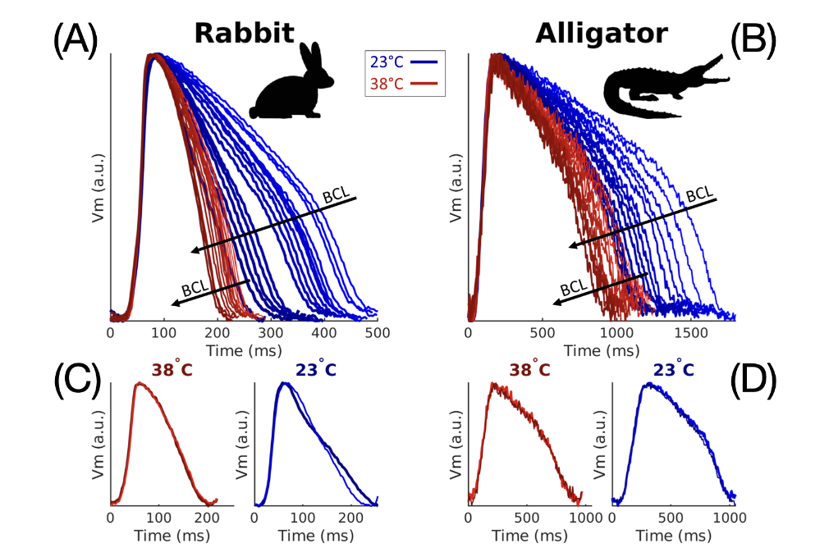

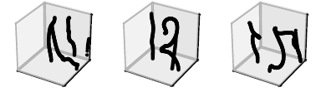

Research Scientist
Home About Us Research Publications People Teaching News Press Software Lab Pics
Google Scholar Link
Defibrillate you later, alligator; Q10 scaling and refractoriness keeps alligators from fibrillation.
C Herndon, HC Astley, T Owerkowicz, FH Fenton Integrative Organismal Biology
2;
Robust data assimilation with noise: Applications to cardiac dynamics
CD Marcotte, FH Fenton, MJ Hoffman, EM Cherry Chaos: An Interdisciplinary Journal of Nonlinear Science 31 (1), 013118
1;

